Slide 1
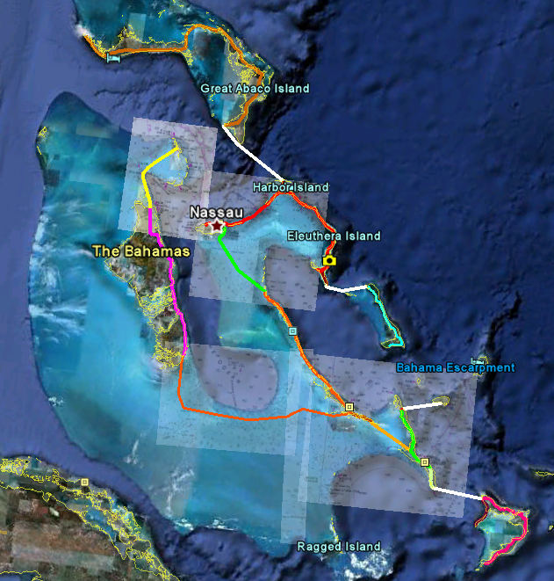
White pathways are too deep for Hyrail deployment and will require an alternative mode of transport, i.e., hydrogen ferry service, etc.
Mass Transit
and
Public Infrastructure
Solar and Hydrogen powered High Speed Elevated Mag-Lev with embedded public utilities conduit that houses;
Super Conducting Cable for distribution of electricity
High density fiber optics for communications and internet
Conduit with the ability to flow liquid and/or vapor fuels.
Produces one megawatt of electrical power per solar hour per mile.
Only uses about half the energy it creates for operation of transit system and sub systems.

Slide 2
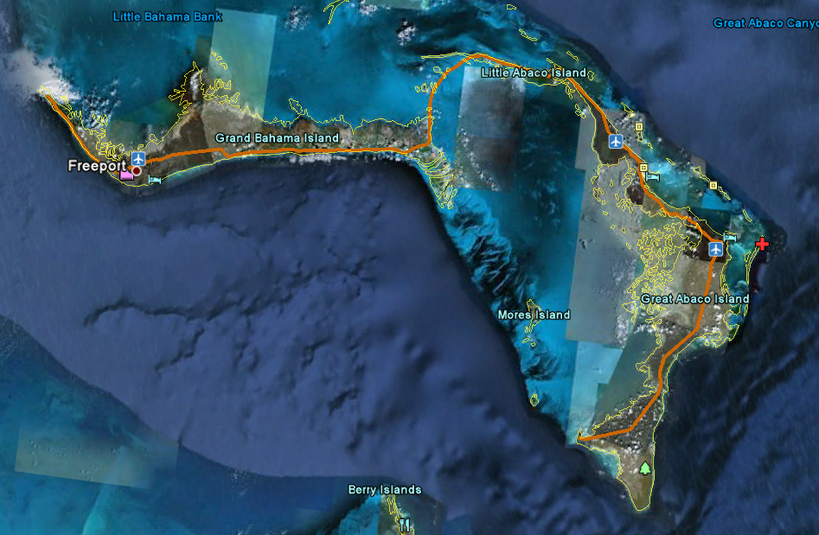

Slide 3
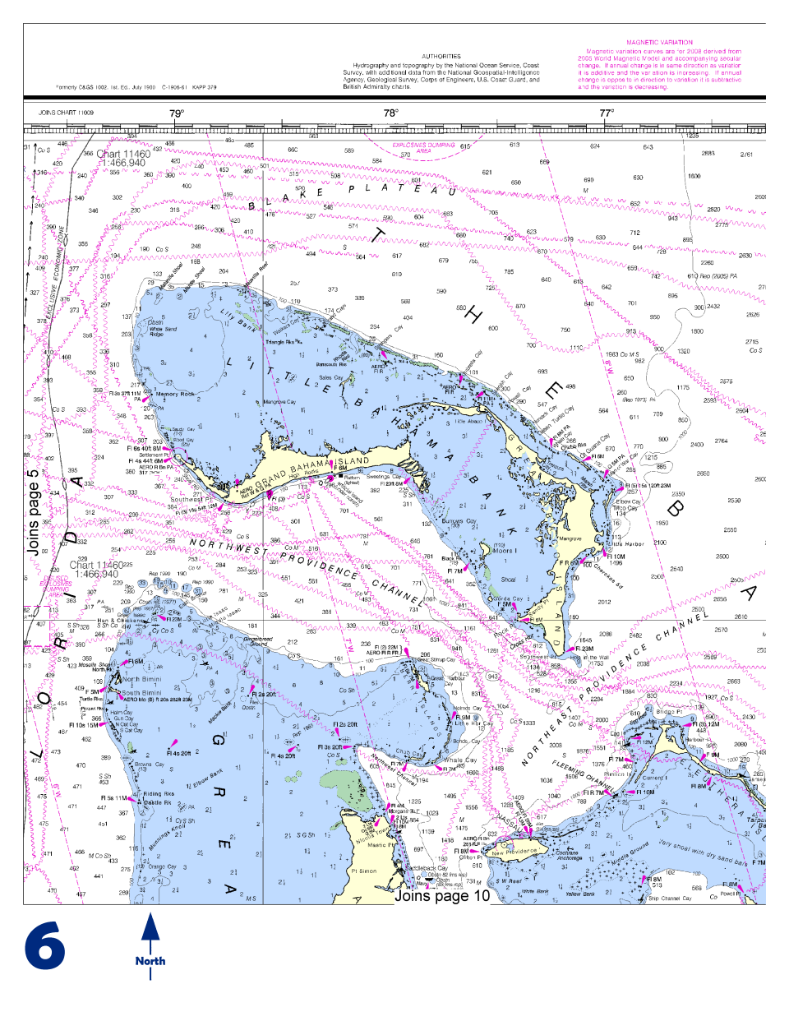
Depths are shown in fathoms (6.0 ft.)
We should be able to safely and effectively set our stanchions in 3 to 3 ½ fathoms or 18 ft. to 21 ft. deep waters on average and still maintain an average distance of 35 ft from the water’s surface to the rail to which the transports are attached.

Slide 4
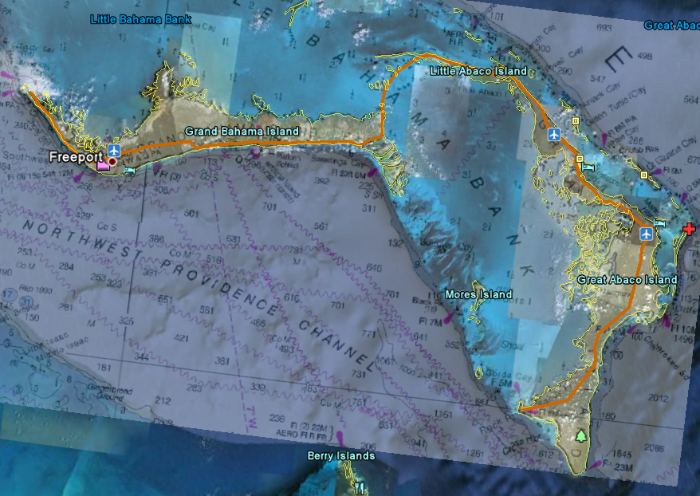

Slide 5
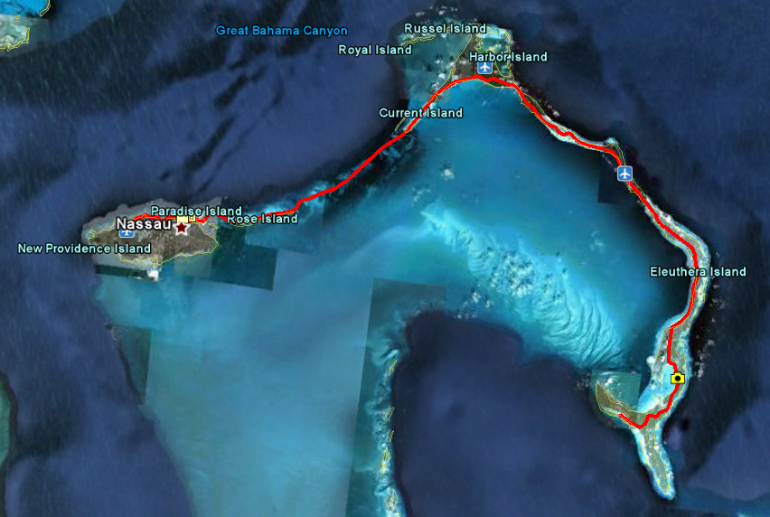
Nassau International Airport to Freetown 140 mi./ 225 km

Slide 6
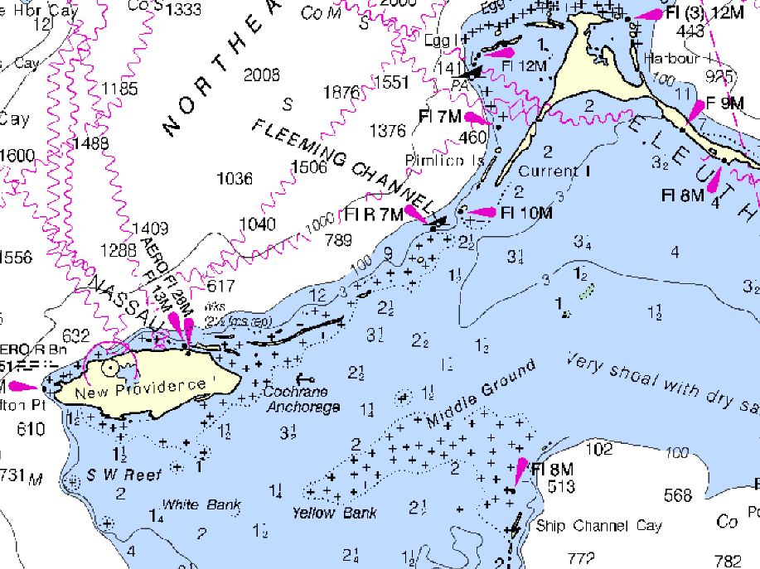

Slide 7
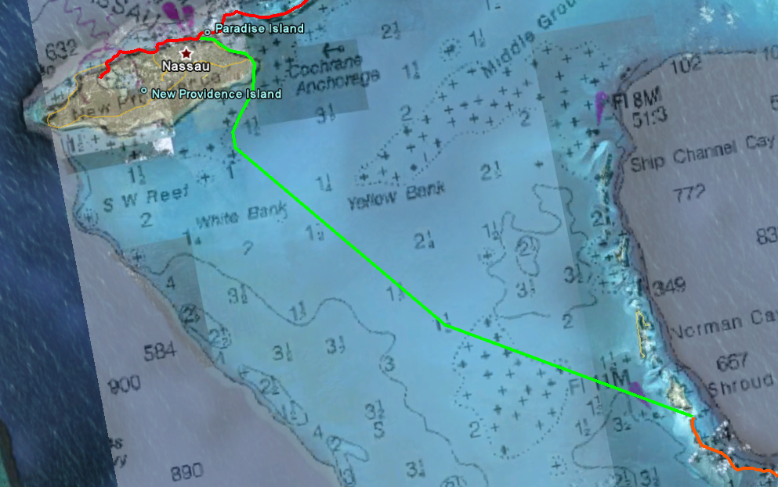

Slide 8
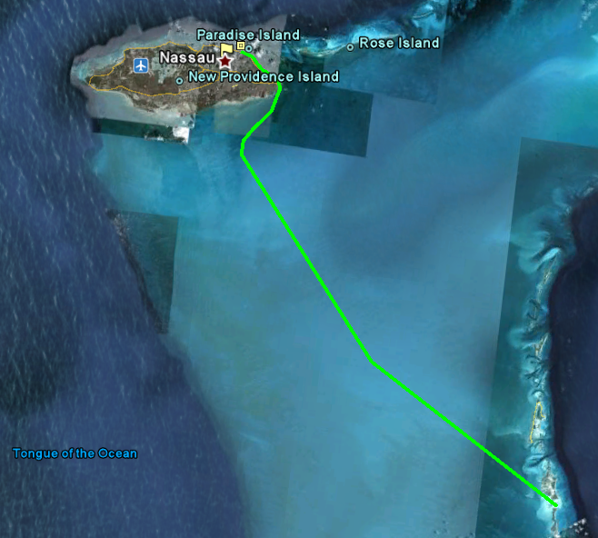

Slide 9
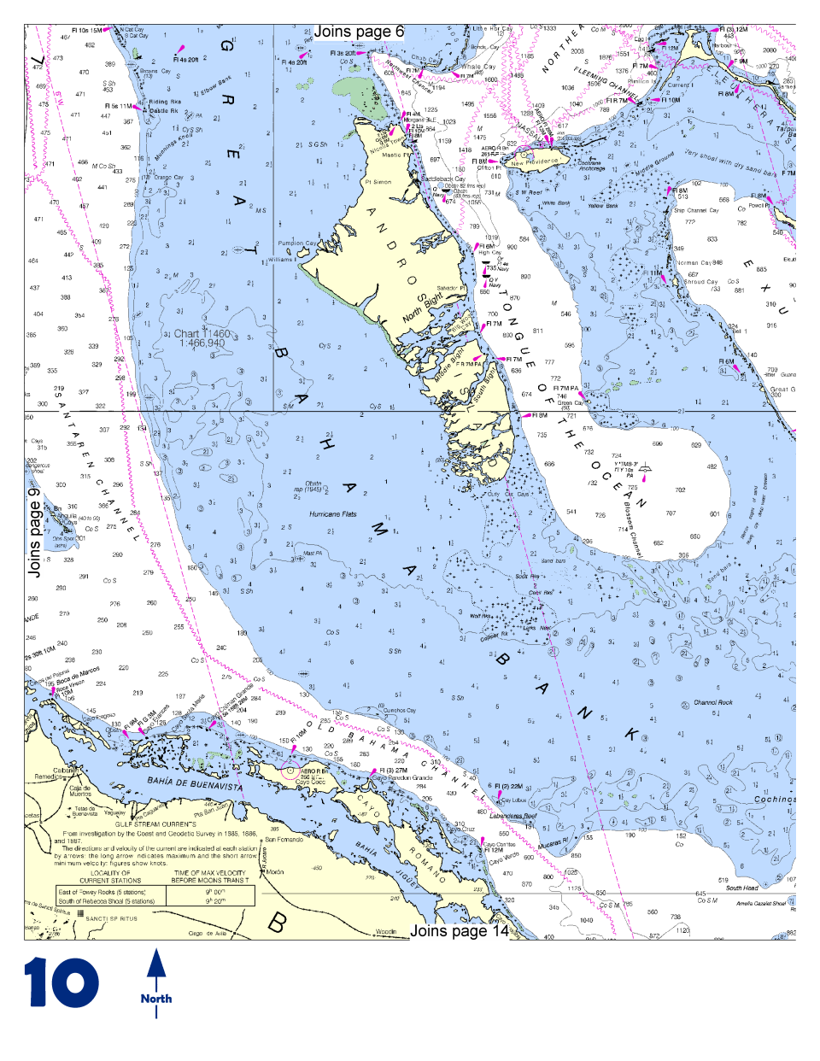

Slide 10
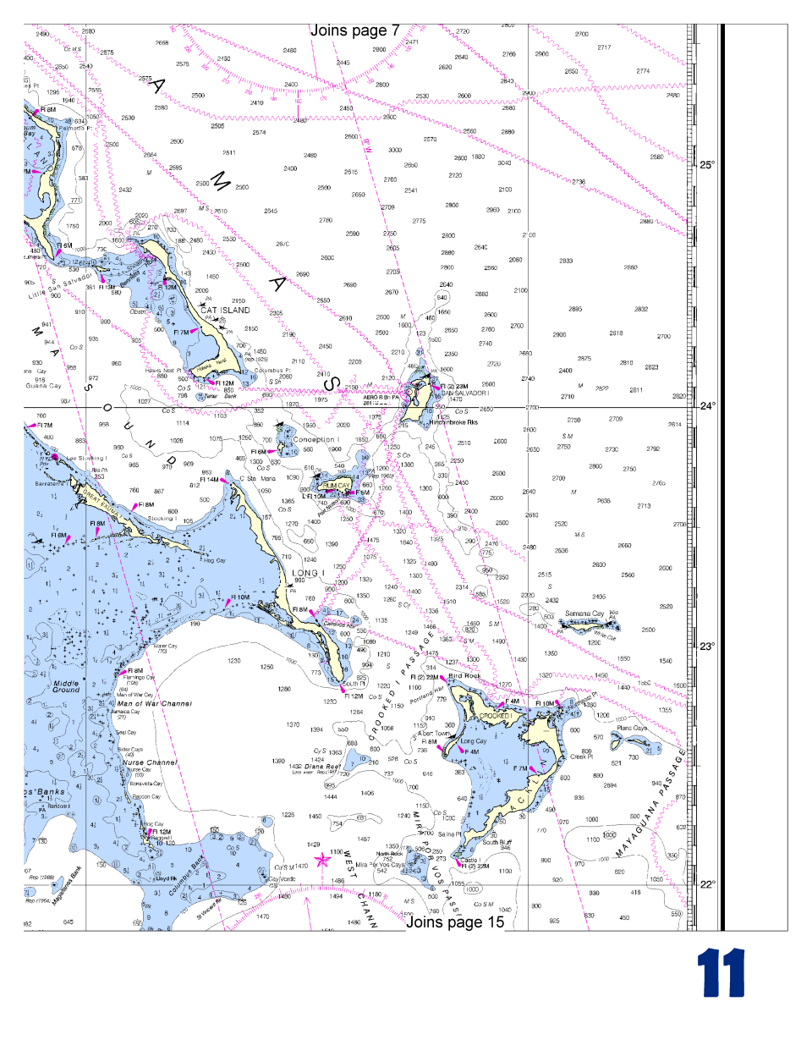

Slide 11
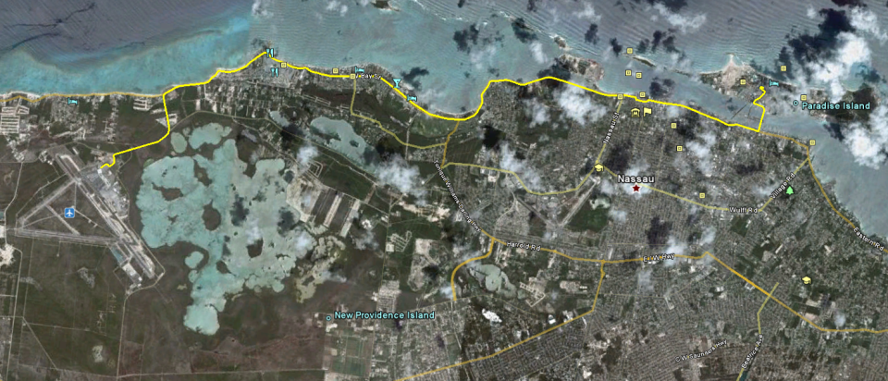


12 mi. / 19.4 km.

Slide 12
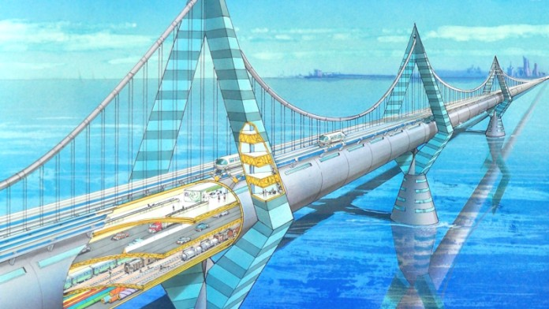

Slide 13
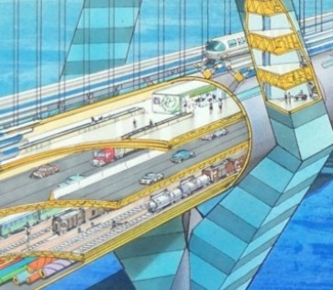

Slide 14
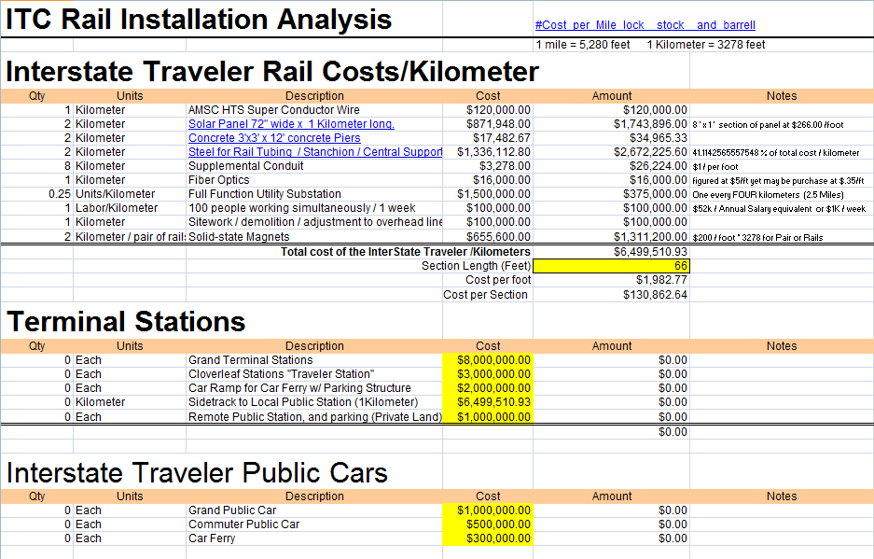
Total components required to build one kilometer of rail including
utility sub stations, Site work, demolition, adjustment to
overhead lines and labor cost.
Cost Per
Item
Total cost to construct rail and substructure
Including embedded public utilities conduit
Total cost per kilometer of rail sections and utilities conduit
Additional Cost for individual transport vehicles
Table of Contents

Slide 15
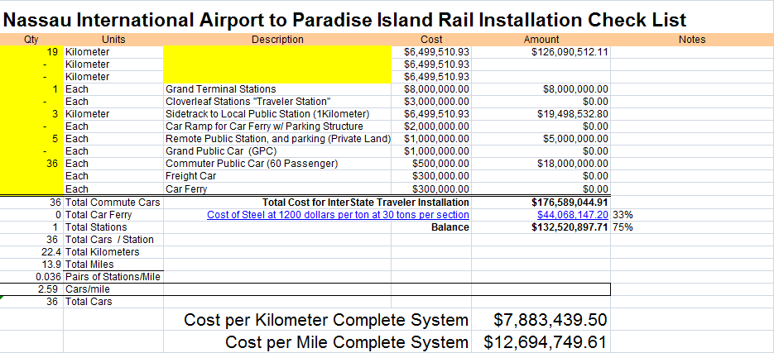
*Plus additional cost for construction over water

Slide 16
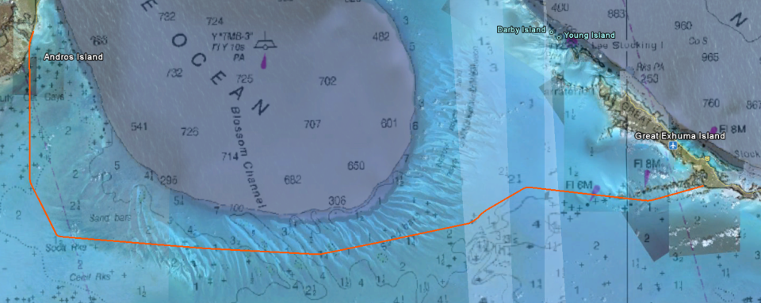
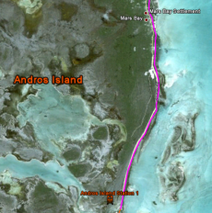
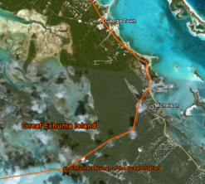
Great Exhuma Island to Andros Island Water Route

Slide 17
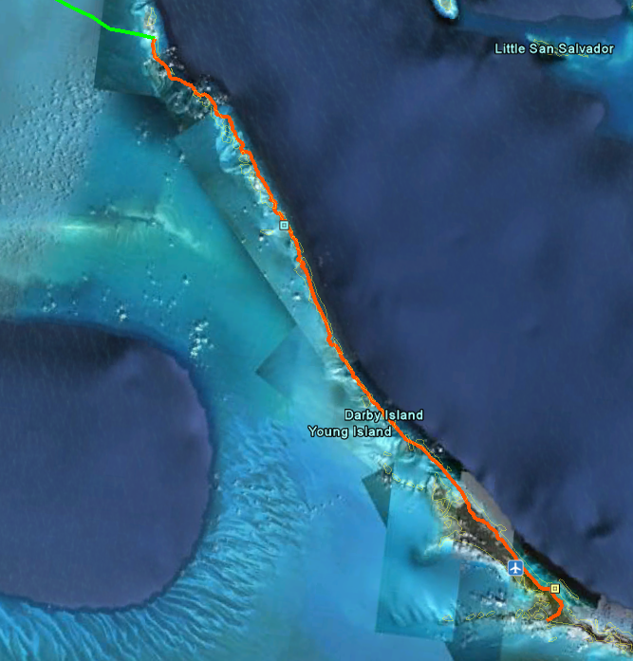
The water route from Nassau would come ashore at the upper portion of the island chain in the southern portions of Exhuma, connecting all of the smaller islands and supplying water, electricity and communications, not to mention transportation.

Slide 18
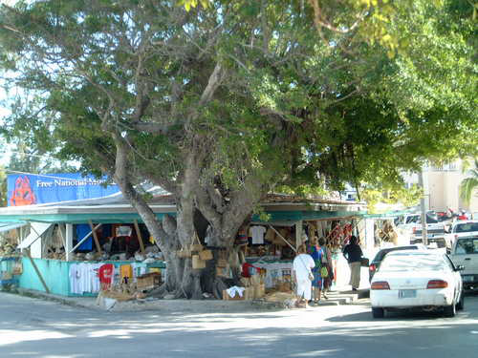
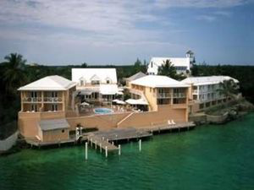
Straw market in Georgetown
The amount of usable land would grow exponentially and new areas would be quickly populated attracting new businesses and greatly increasing commerce.
CLUB PEACE AND PLENTY
9137 QUEENS HIGHWAY
ELIZABETH HARBOUR
GEORGE TOWN, 29055 BS
The Exumas

Slide 19
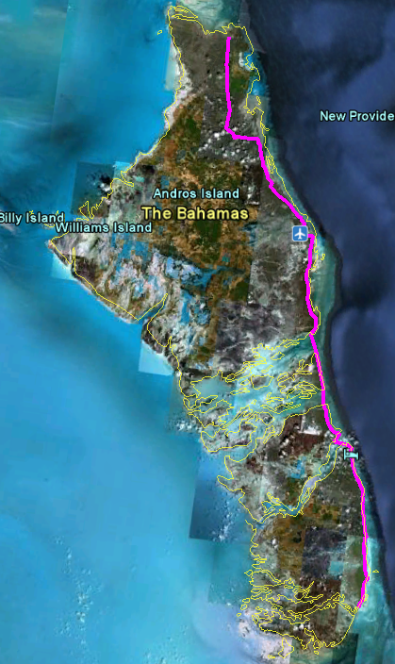
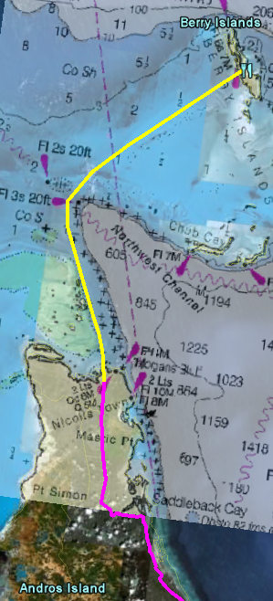
110. mi. / 177 km

Slide 20
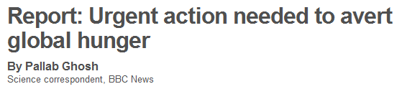
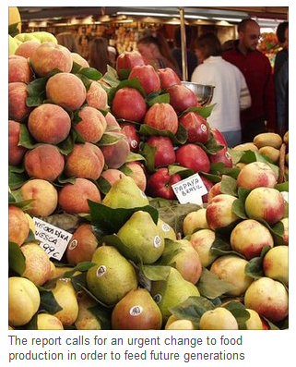
A UK government-commissioned study into food security has called for urgent action to avert global hunger.
The Foresight Report on Food and Farming Futures says the current system is unsustainable and will fail to end hunger unless radically redesigned. It is the first study across a range of disciplines deemed to have put such fears on a firm analytical footing.
The report is the culmination of a two-year study, involving 400 experts from 35 countries. According to the government's chief scientific adviser, Professor Sir John Beddington, the study provides compelling evidence for governments to act now.
The report emphasizes changes to farming, to ensure that increasing yields does not come at
the expense of sustainability and to provide incentives to the agricultural sector that address malnutrition. It also recommends that the most resource-intensive types of food are curbed and that waste is minimized in food production. "We know in the next 20 years the world population will increase to something like 8.3 billion people," he told BBC News. "We know that urbanization is going to be a driver and that something of the order of 65-70% of the world's population will be living in cities at that time. "We know that the world is getting more prosperous and that the demand for basic commodities - food, water and energy - will be rising as that prosperity increases, increasing at the same time as the population."
He warned: "We have 20 years to arguably deliver something of the order of 40% more food; 30% more available fresh water and of the order of 50% more energy. We can't wait 20 years or 10 years indeed - this is really urgent.“

Slide 21
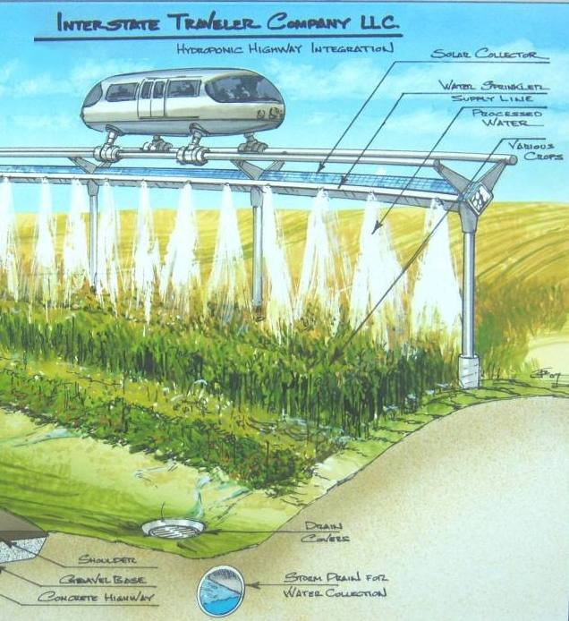

Slide 22
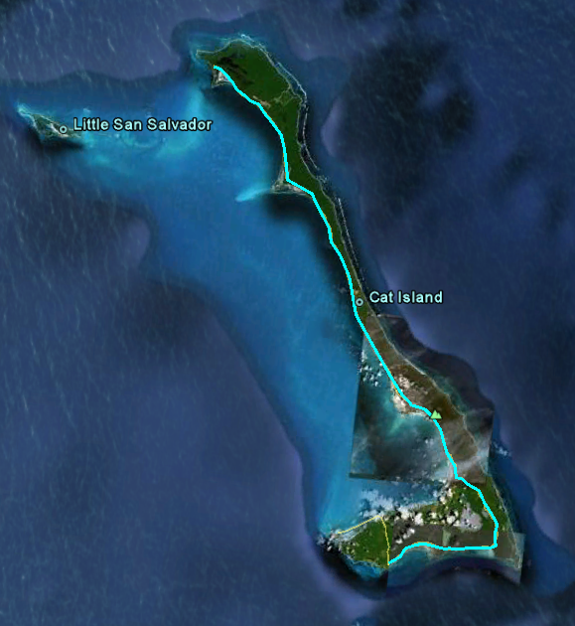
54.7 mi. / 88.0 km.

Slide 23
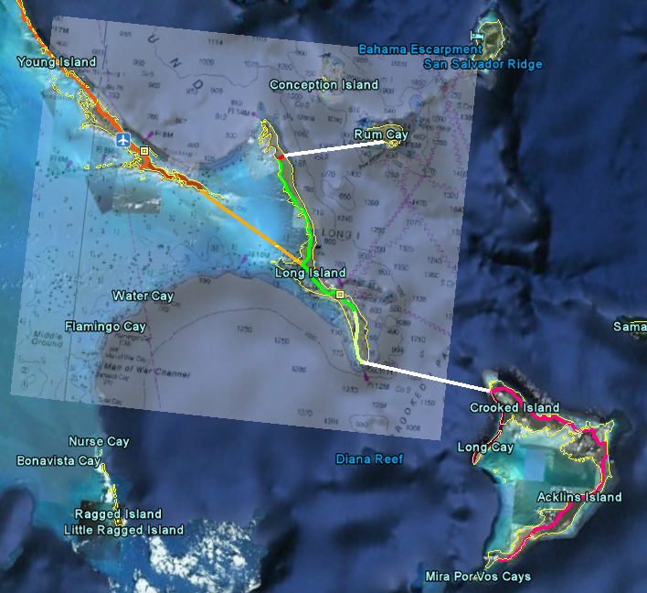
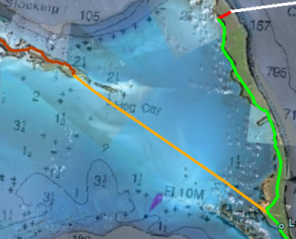

Slide 24
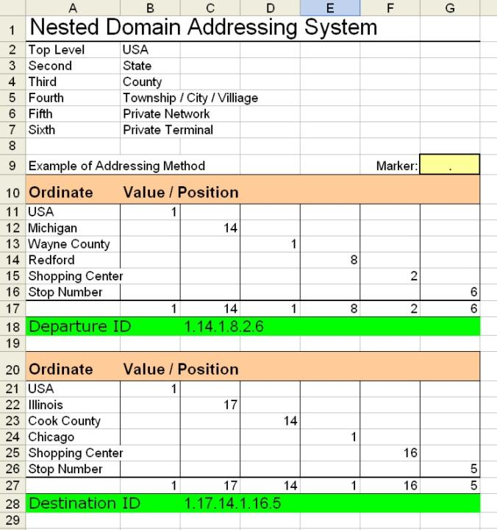

Slide 25
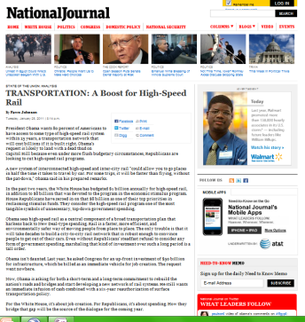
STATE OF THE UNION: ANALYSIS
TRANSPORTATION: A Boost for High-Speed Rail
By Fawn Johnson
Tuesday, January 25, 2011 | 8:14 p.m.
President Obama wants 80 percent of Americans to have access to some type of high-speed rail system within 25 years, a transportation network that will cost billions if it is built right. Obama’s request is likely to land with a dead thud on Capitol Hill because even under more flush budgetary circumstances, Republicans are looking to cut high-speed rail programs.
A new system of interconnected high-speed and inter-city rail “could allow you to go places in half the time it takes to travel by car. For some trips, it will be faster than flying, without the pat-down,” Obama said in his prepared remarks.
In the past two years, the White House has budgeted $1 billion annually for high-speed rail, in addition to $8 billion that was devoted to the program in the economic stimulus program. House Republicans have zeroed in on that $8 billion as one of their top priorities in reclaiming stimulus funds. They consider the high-speed rail program one of the most tangible symbols of unnecessary, top-down government spending.
Obama sees high-speed rail as a central component of a broad transportation plan that harkens back to New Deal-type spending. Rail is a faster, more efficient, and environmentally safer way of moving people from place to place. The only trouble is that it will take decades to build a city-to-city rail network that is robust enough to convince people to get out of their cars. Even without Republicans’ steadfast refusal to consider any form of government spending, marshaling that kind of investment over such a long period is a tall order. Obama isn’t daunted. Last year, he asked Congress for an up-front investment of $50 billion for infrastructure, which he billed as an immediate vehicle for job creation. The request went no where. Now, Obama is asking for both a short-term and a long-term commitment to rebuild the nation’s roads and bridges and start developing a new network of rail systems. He still wants an immediate infusion of cash combined with a six-year reauthorization of surface transportation policy. For the White House, it’s about job creation. For Republicans, it’s about spending. How they bridge that gap will be the source of the dialogue for the coming year.

Slide 26
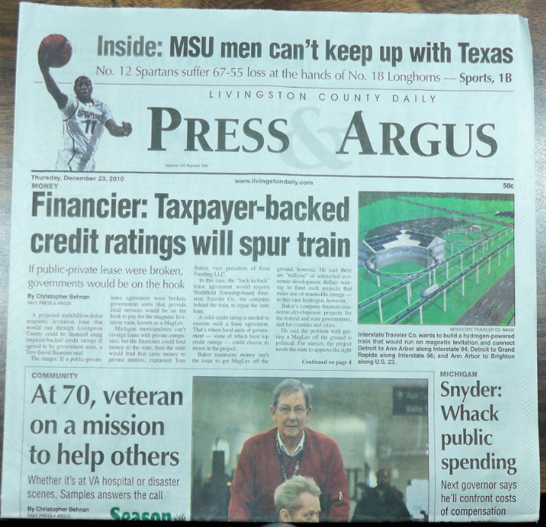

Slide 27
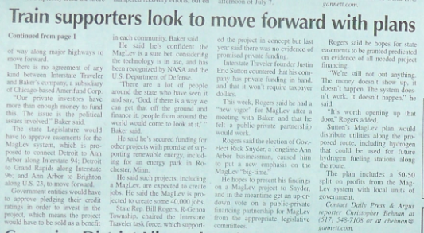

Slide 28
